Slide 1
PNB METLIFE DESIGN SPRINT

Slide 2
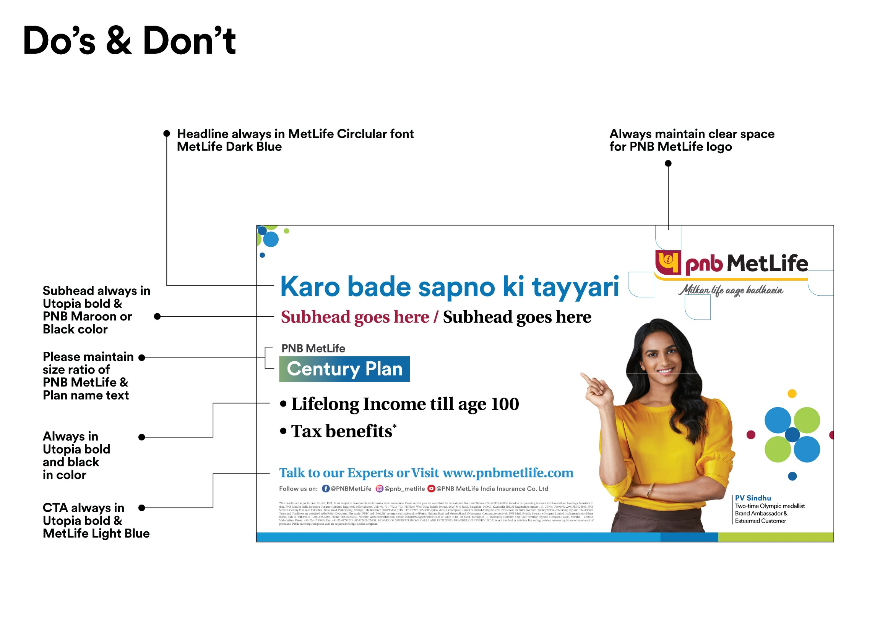

Slide 3
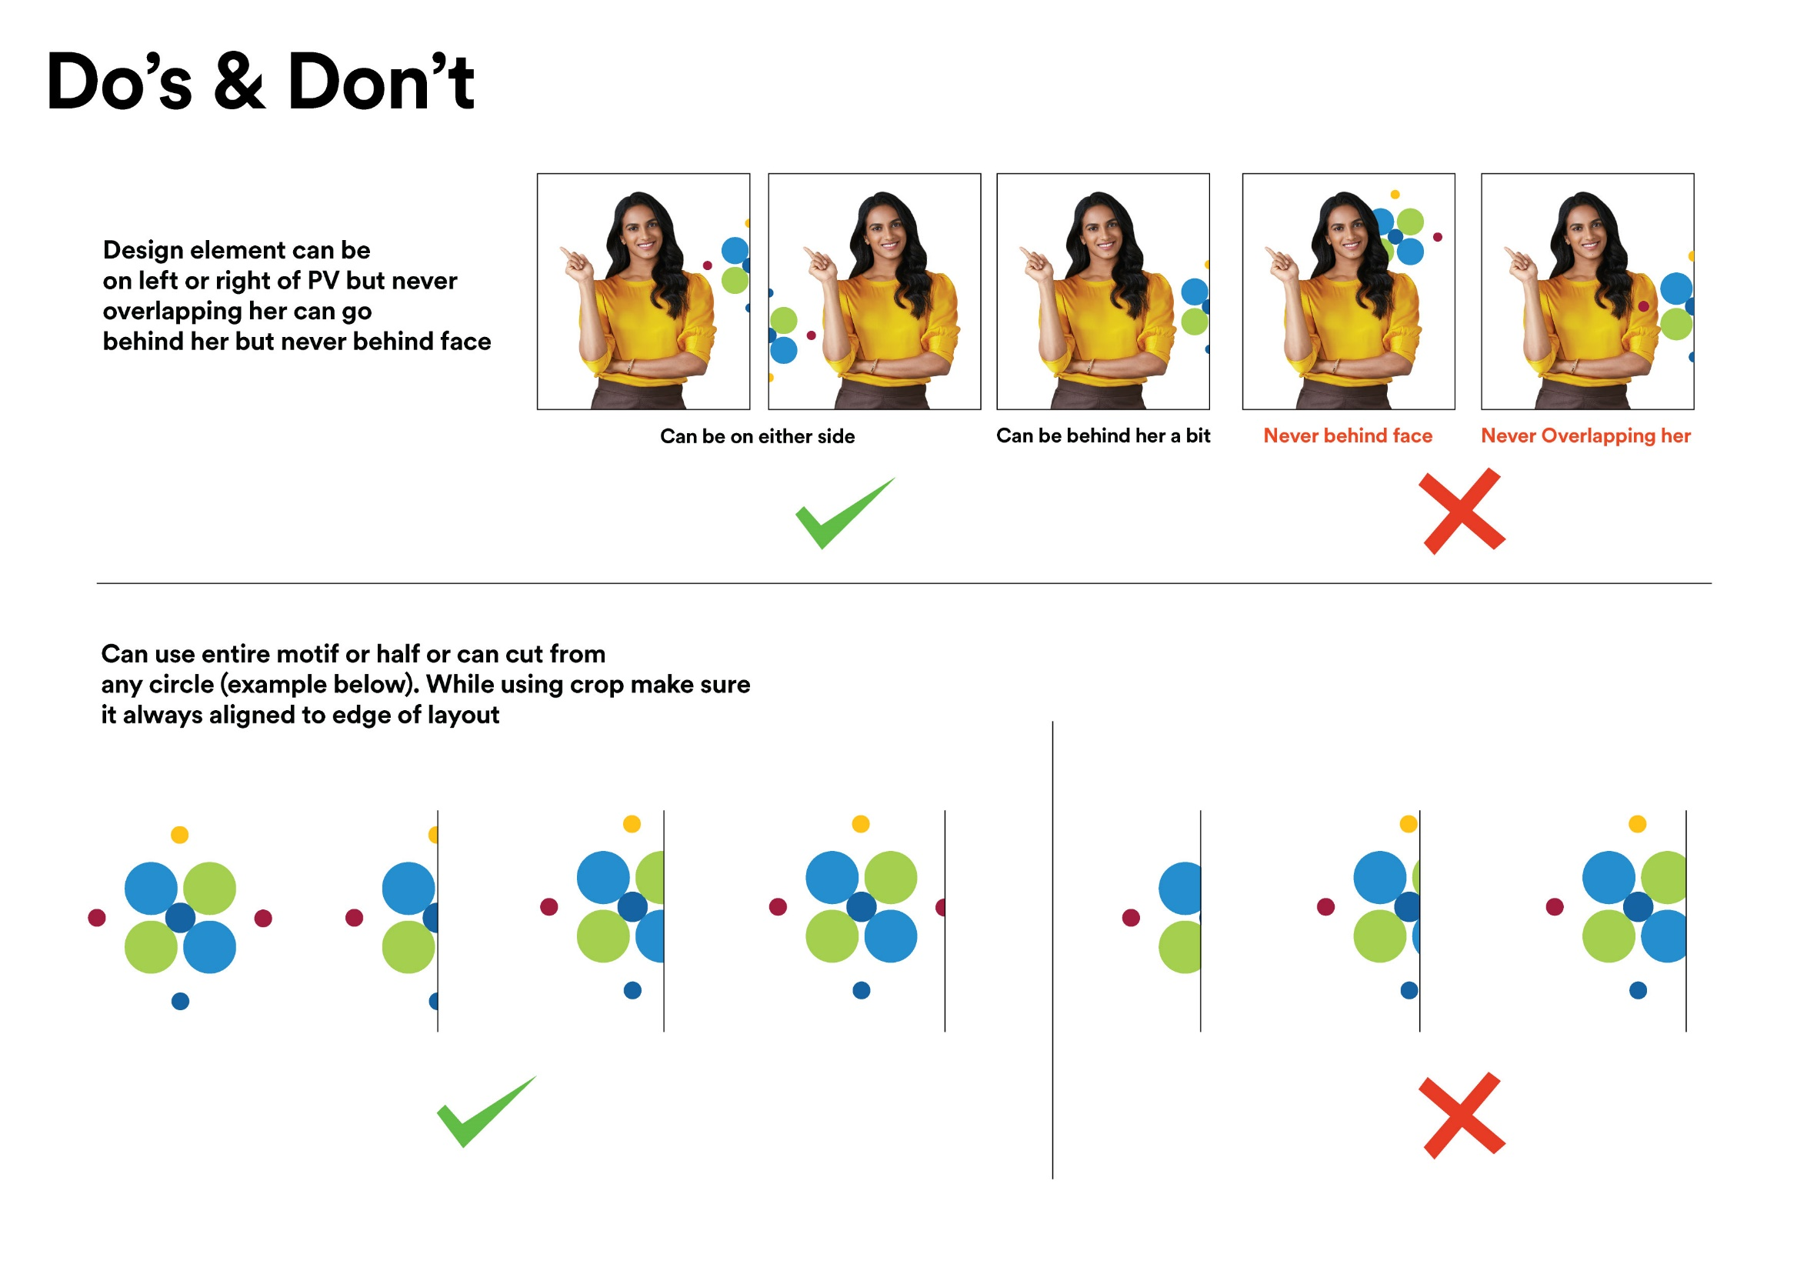

Slide 4




Use in creatives without PVS

Slide 5


Use in creatives without PVS

Slide 6
THANK YOU

